Slide 1
Global Tuberculosis Programme Data Analysis
Presented By- Swati Mishra
UIN- (01212676)
Data Visualization - CS625

Slide 2
Introduction
WHO's Global Tuberculosis Programme, which strives for a TB-free world with no TB-related deaths, illnesses, or suffering. The team's goal is to lead and coordinate the worldwide campaign to end the TB epidemic via multisectoral action, innovation, and universal access to people-centered prevention and care.
The dataset are divided into below categories:
WHO TB burden estimates
WHO TB burden estimates
WHO TB incidence estimates
Data provided by countries and territories
Budgets for TB
Expenditure and utilization of health services for TB

Slide 3
Questions
What are the risk factors involved in TB case infections with respect to different region?
What is the low, high, best estimate for each country with respect to the total population?
What are the cost of different Programme (including Budget, Expected Funding ,Acutual Expenditure and Funds Received)?
Number of patient expected to start MDR-TB treatment w.r.t to the facilities they choose.

Slide 4
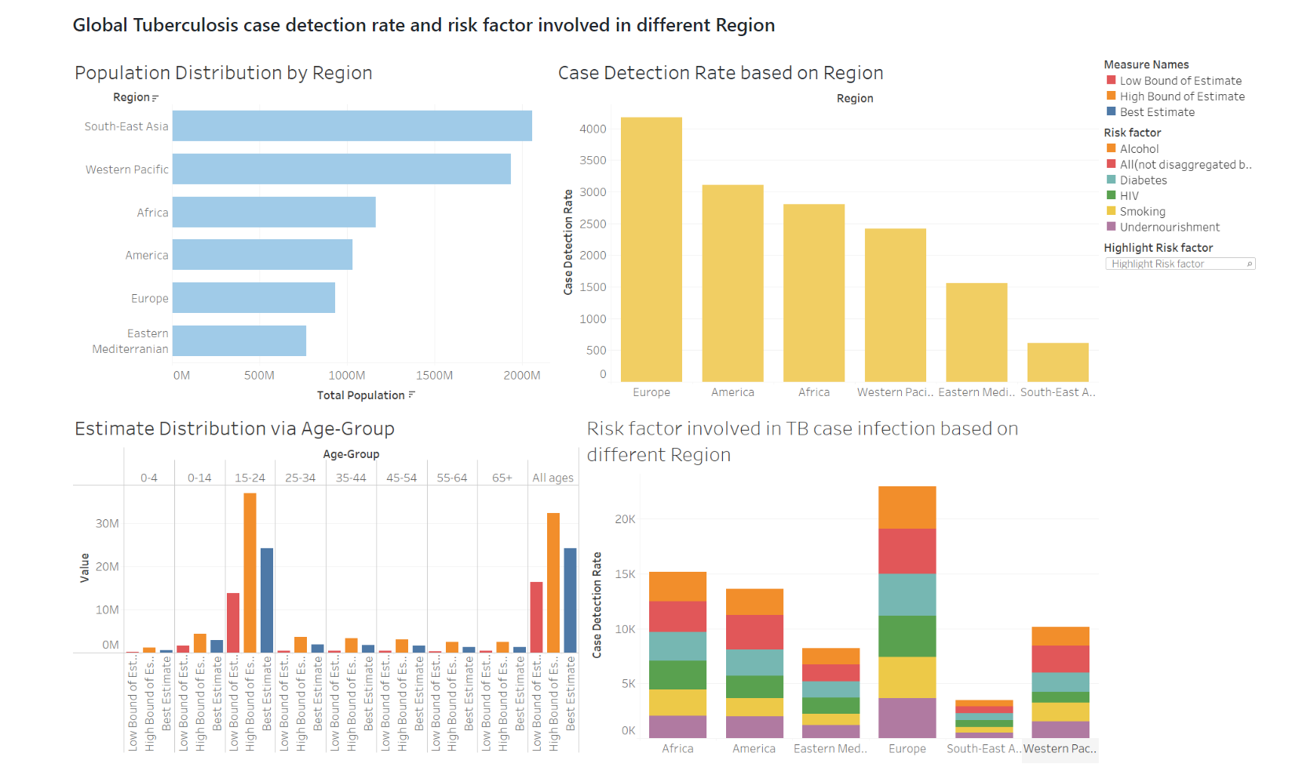

Slide 5
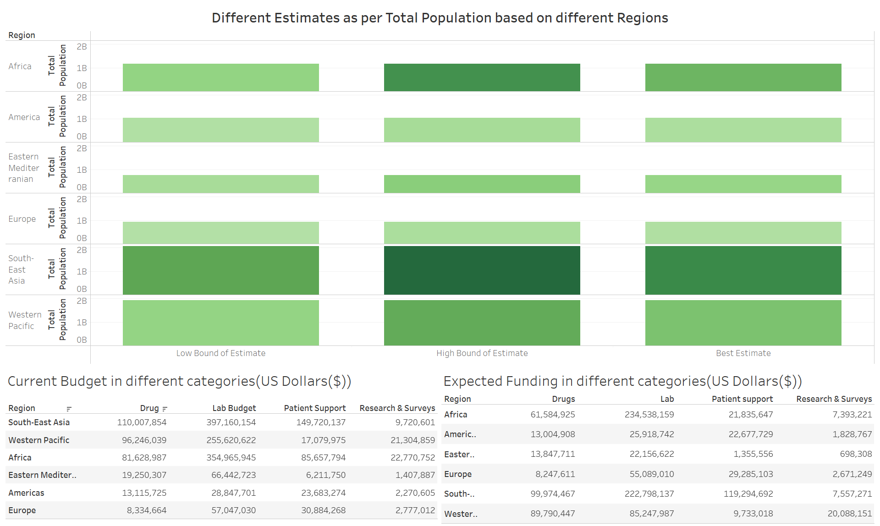

Slide 6
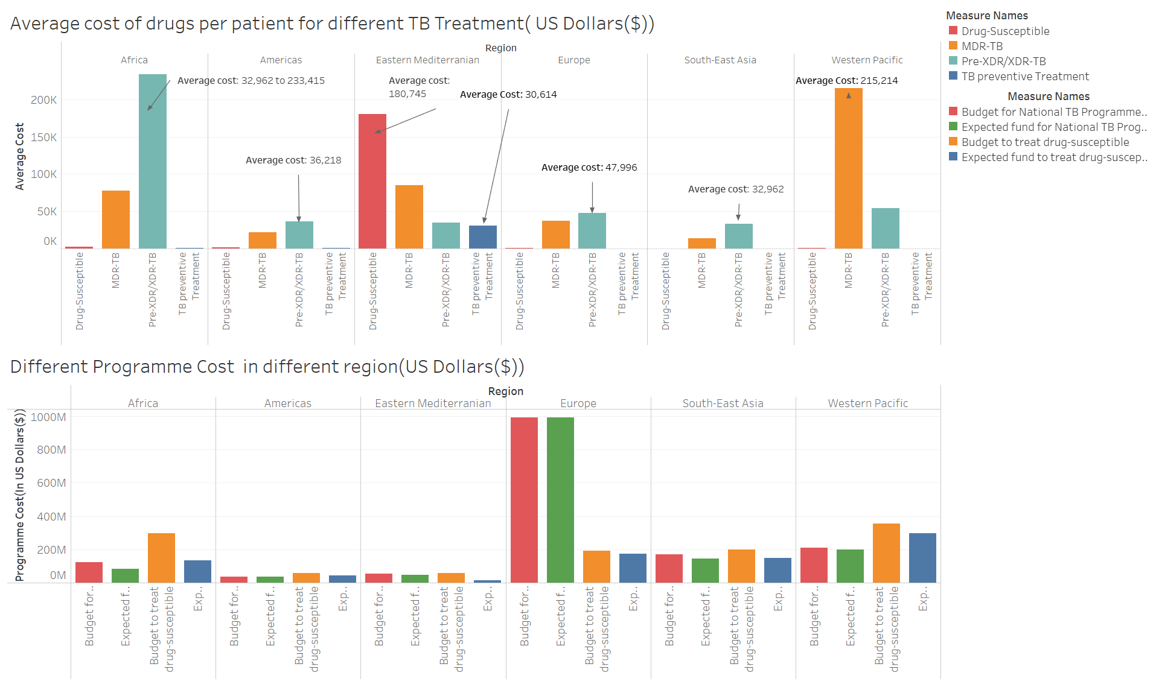

Slide 7
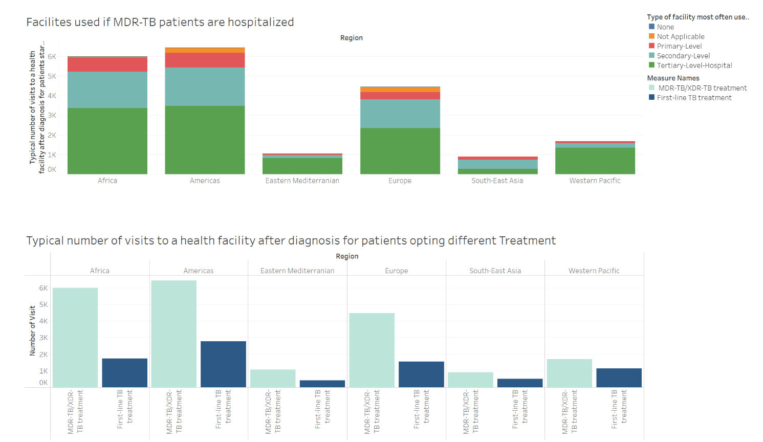

Slide 8
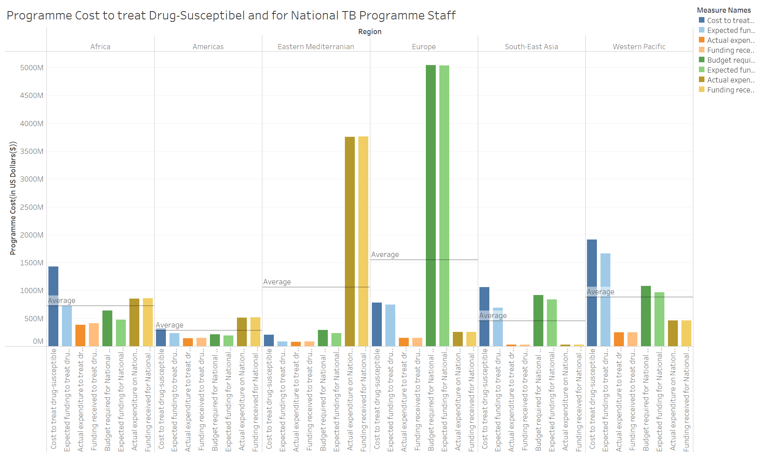

Slide 9
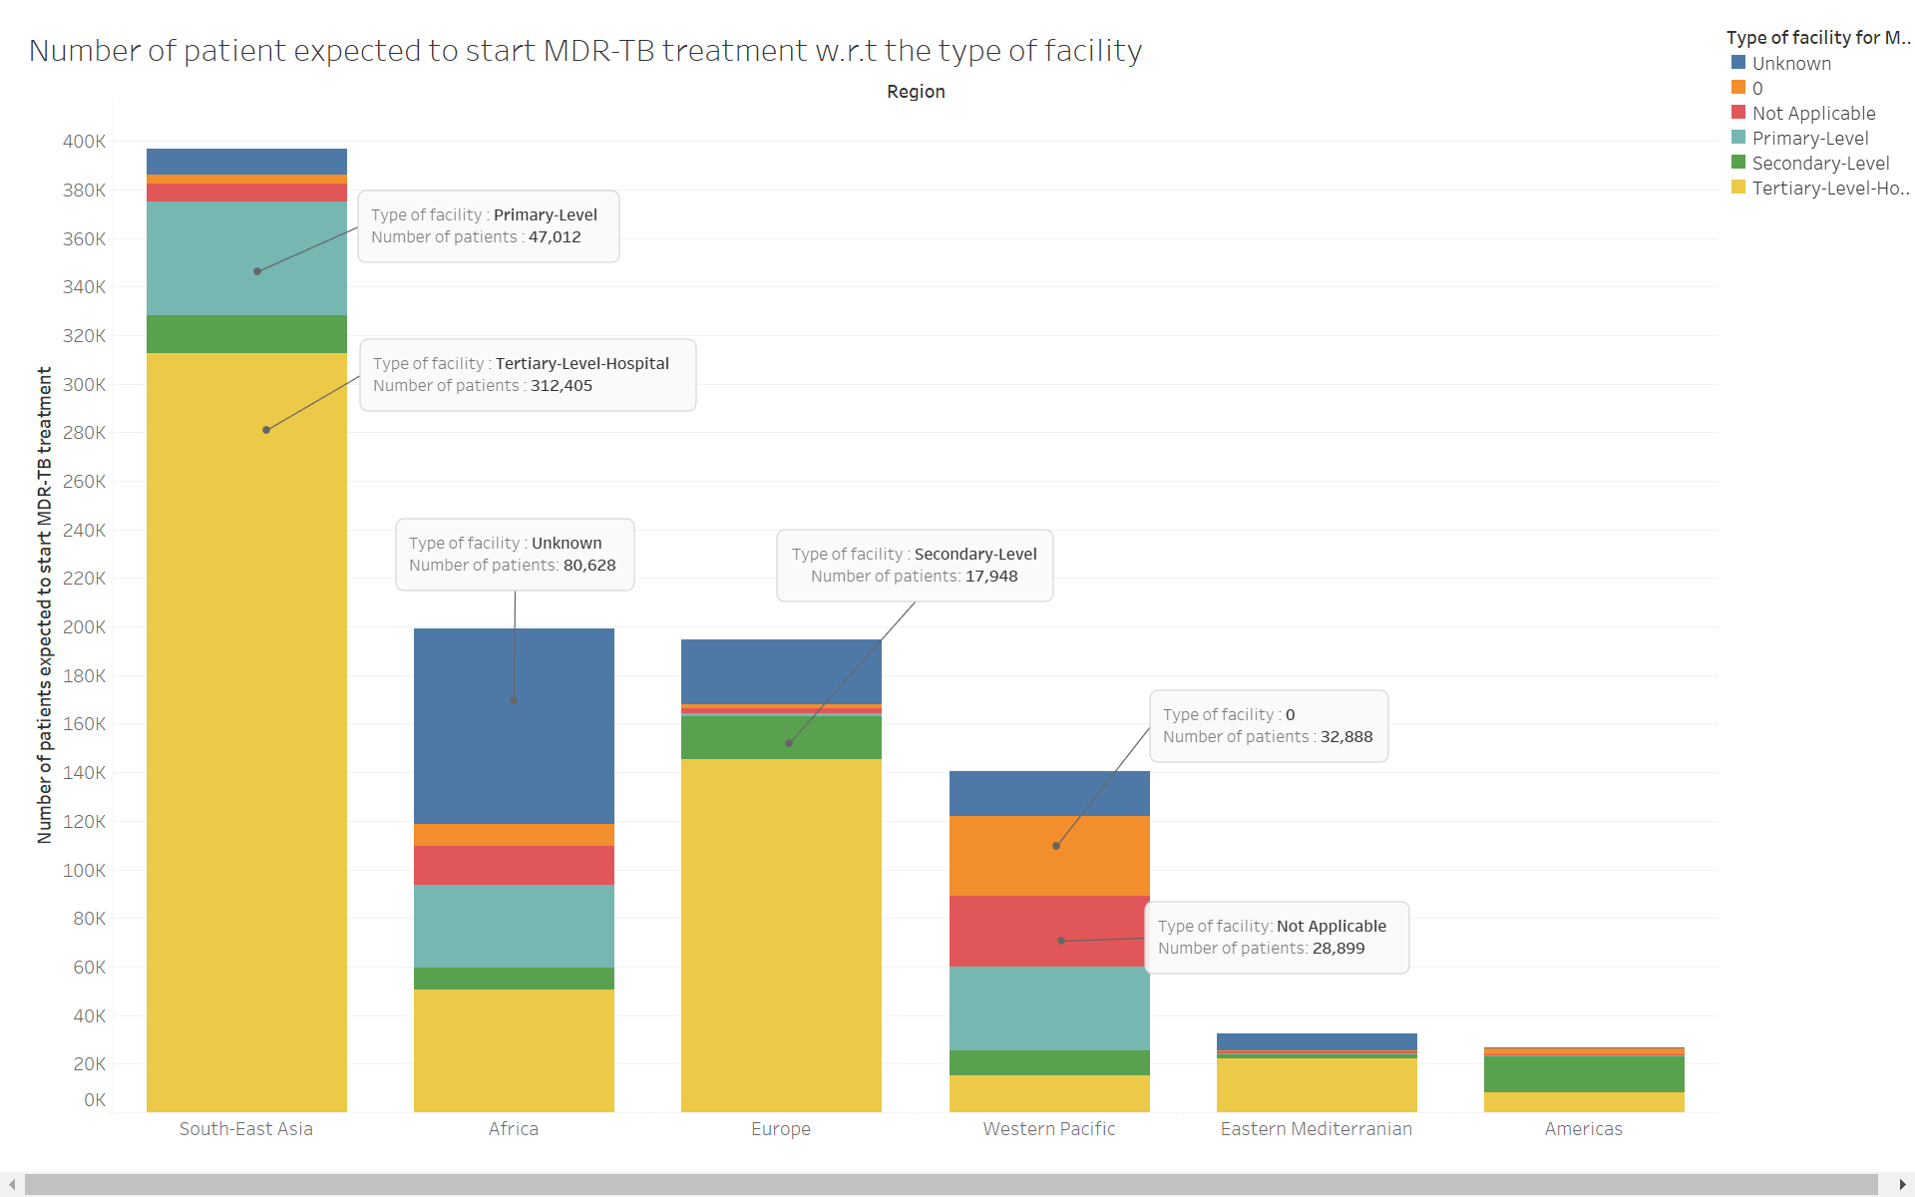

Slide 10
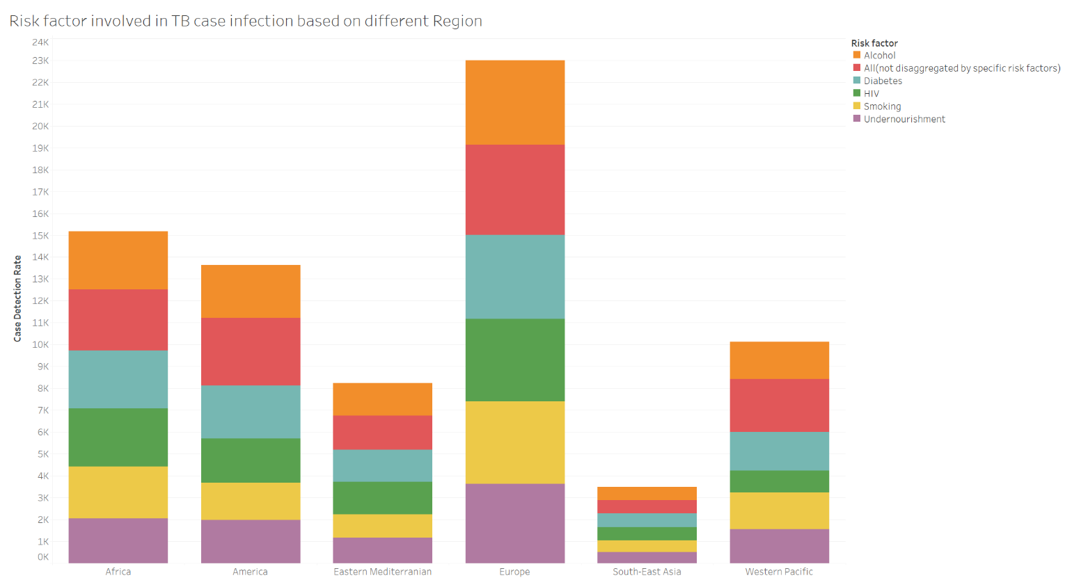
What are the risk factors involved in TB case infections with respect to different region?

Slide 11
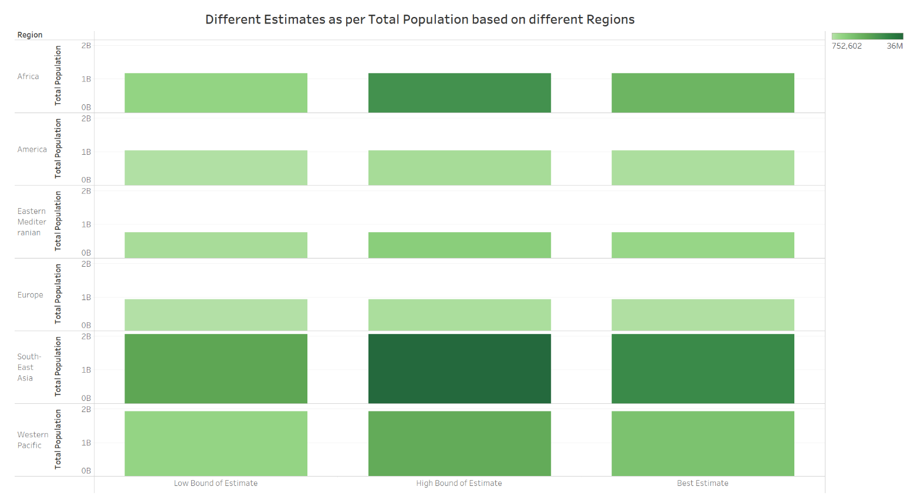
What is the low, high, best estimate for each country with respect to the total population?

Slide 12
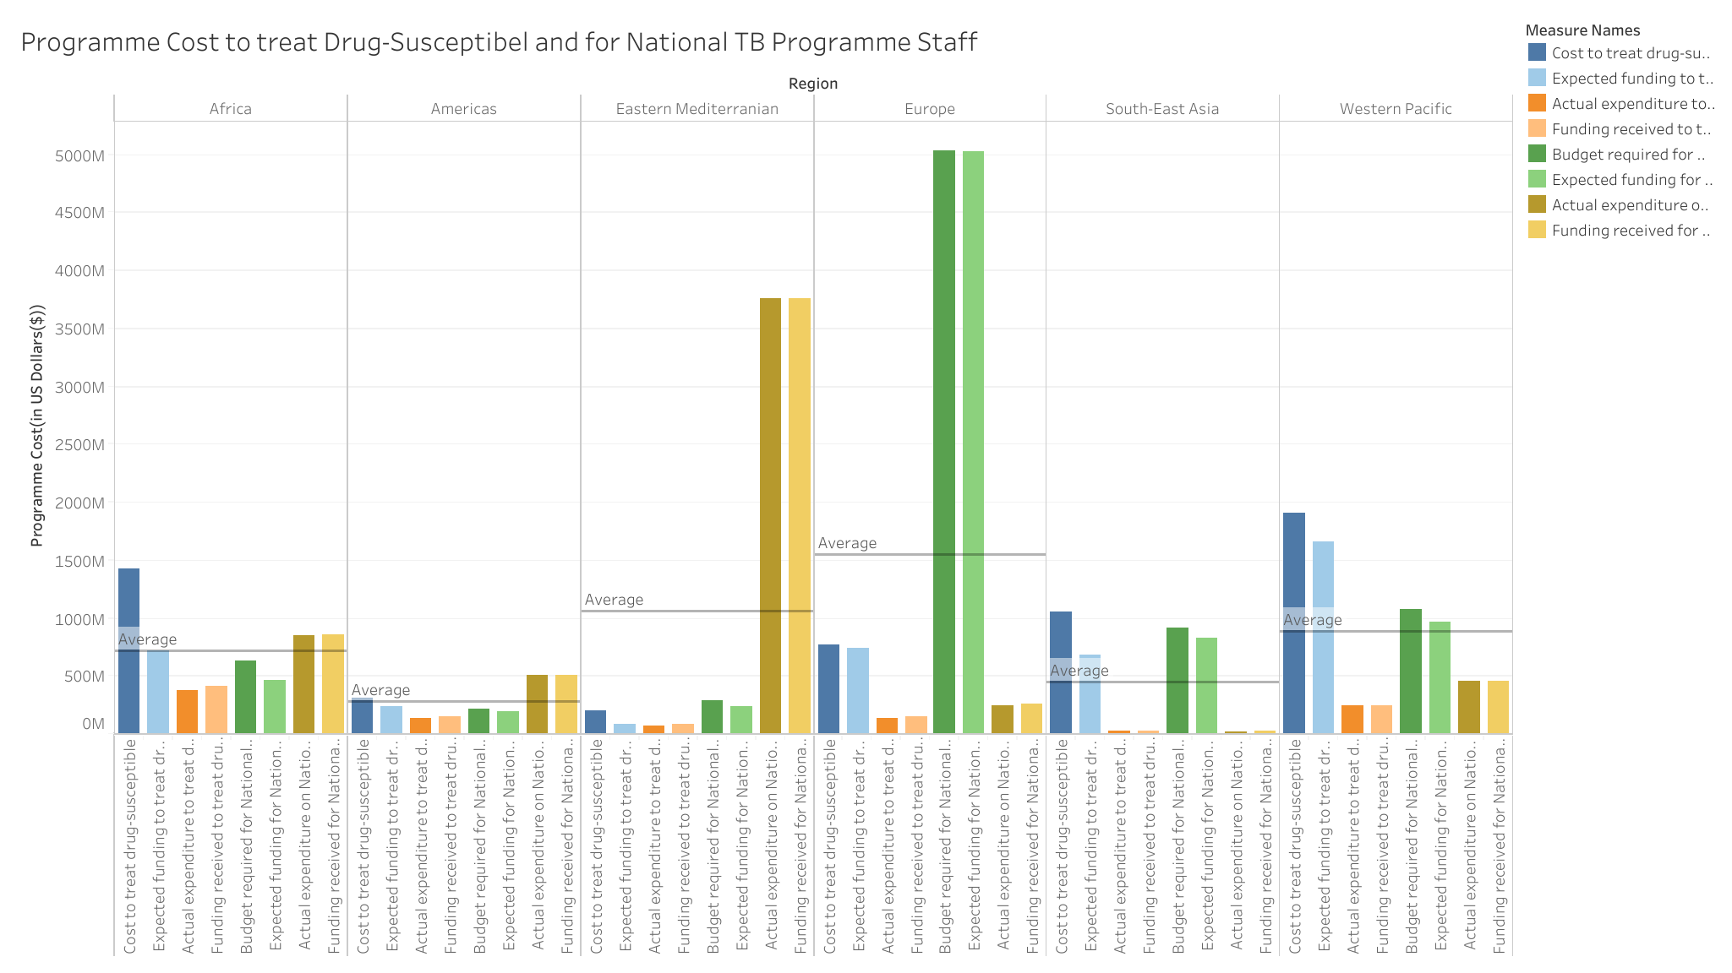
What are the cost of different Programme (including Budget, Expected Funding,Acutual Expenditure and Funds Received)?

Slide 13
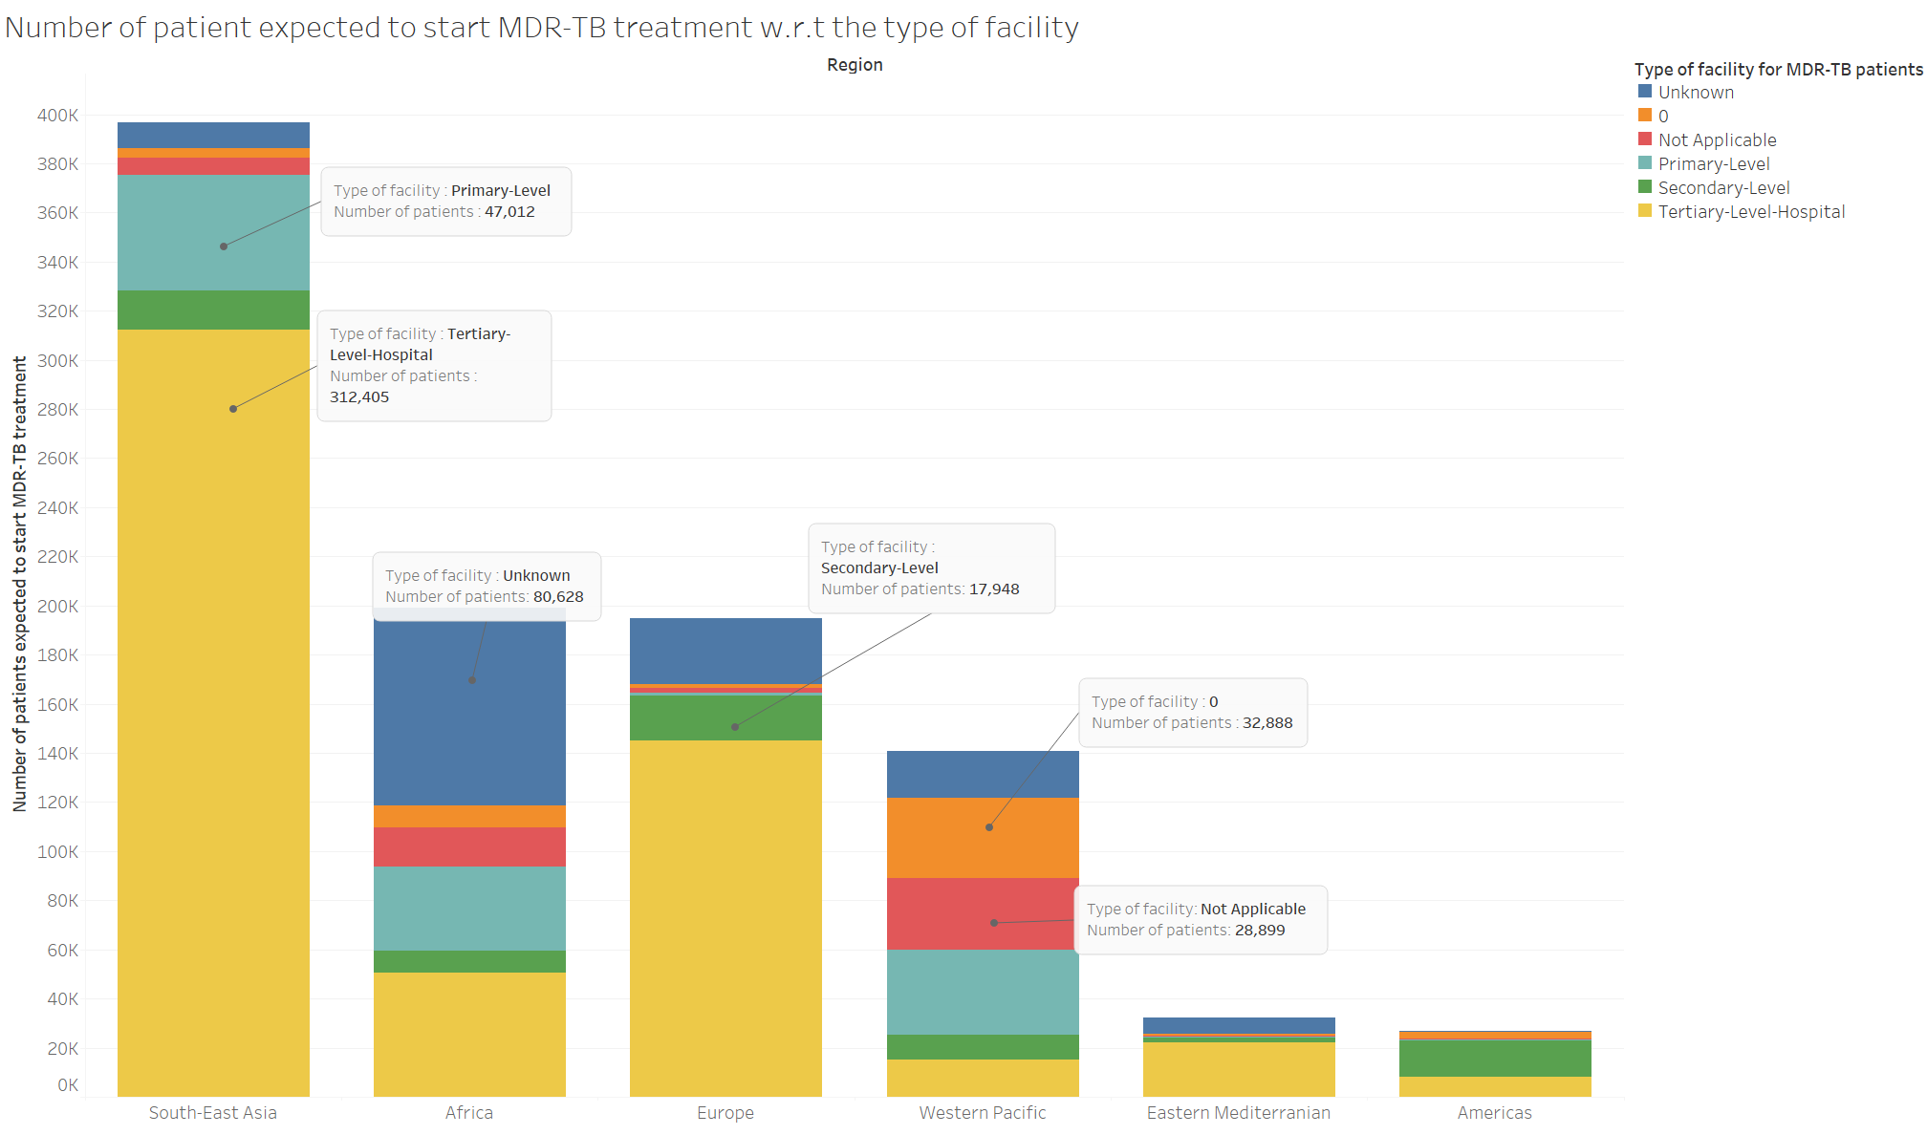
Number of patient expected to start MDR-TB treatment w.r.t to the facilities they choose.

Slide 14
References
https://www.who.int/teams/global-tuberculosis-programme/data
https://www.who.int/news-room/fact-sheets/detail/tuberculosis
https://r4ds.had.co.nz/exploratory-data-analysis.html

